Slide 1

Presentation On Android Chat Application
Presented by –
Rahul Joshi
Project Supervisor
Mr. Akash Chauhan
Dr. Naveen Tiwari

Slide 2
Presentation Outline
Introduction
Objectives
Academic Objectives
Uses
Technological Platforms Used
Languages Used
Salient Features
Application Snapshots
Conclusion

Slide 3
Objectives
The purpose of the chat application is to allow users be able to the chat with each other, like a normal chat application. The users will be able to chat with each other, most likely only from user to user, no group chatting will be developed, unless there is time to do so

Slide 4
Academic Objectives
Learn the process of the implementation of android development.
Understanding the working and application of Firebase.
Designing and developing activities.
Utilizing the minimum resources while working online within a given period of time.
Finally, developing an app which can be accessed by everyone for free.

Slide 5
Uses
The purpose of the chat application is to allow users be able to the chat with each other, like a normal chat application. The users will be able to chat with each other, most likely only from user to user, no group chatting will be developed, unless there is time to do so

Slide 6
Technological Platforms Used
Git Hub : for doing and keeping a record of the work.
Android Studio : editor for android development.
Android Emulator : for trying, testing and implementing different ideas altogether.
firebase : for online database creation.

Slide 7
Tools Used
Android Studio
JAVA
XML
Firebase Realtime Database
Firebase Storage

Slide 8
Salient Features
Effective and efficient way of chatting.
Extra technical knowledge is not required to operate the system.
Available at anytime, anywhere and to anyone.

Slide 9
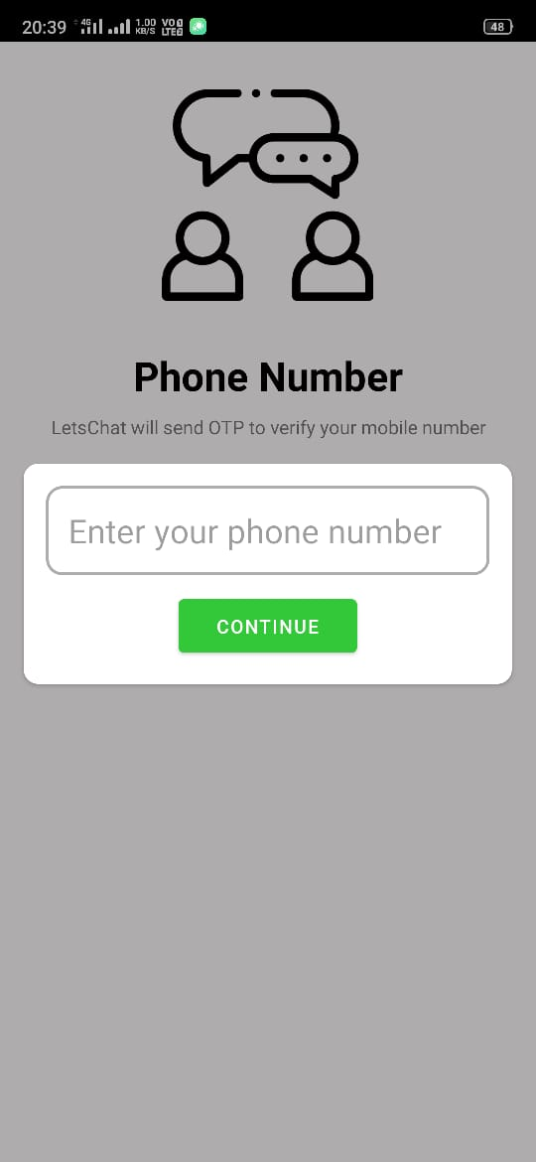
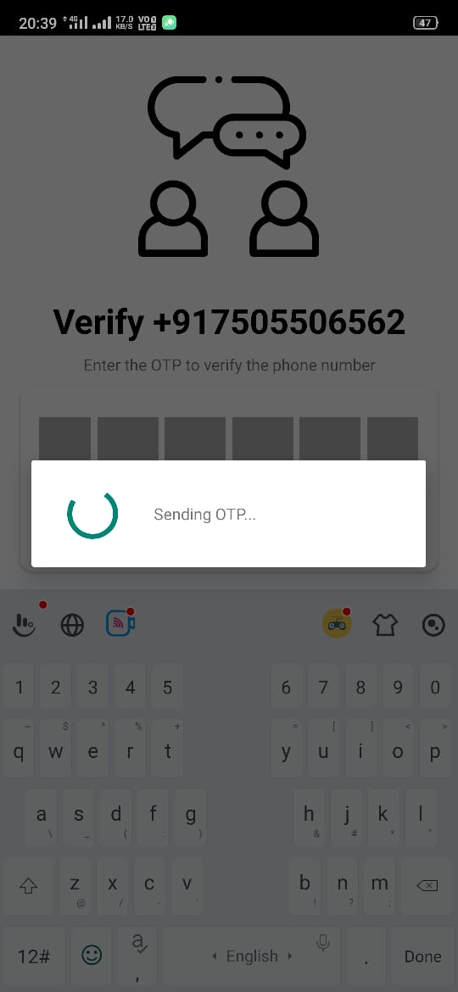
Application Snapshots

Slide 10
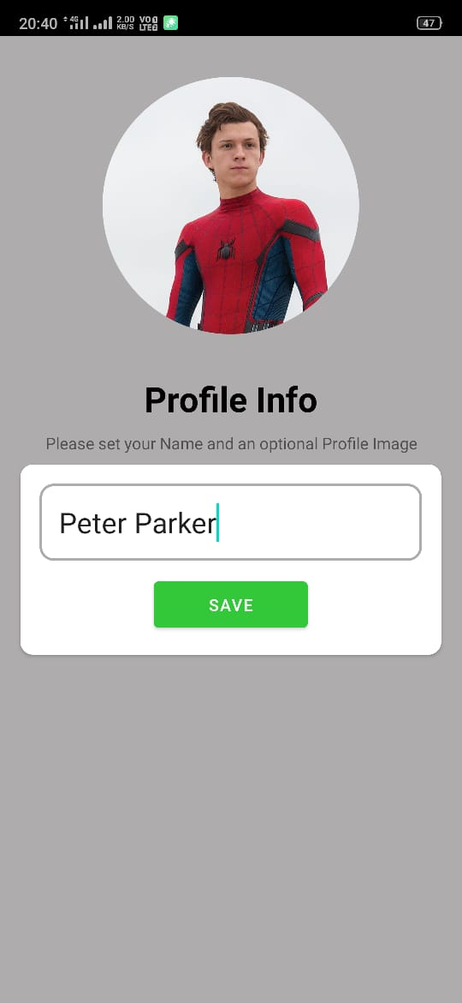
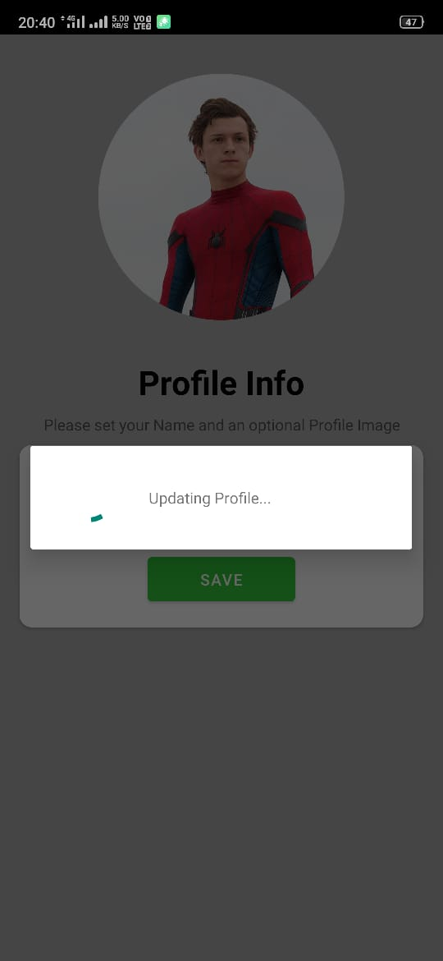
Application Snapshots

Slide 11
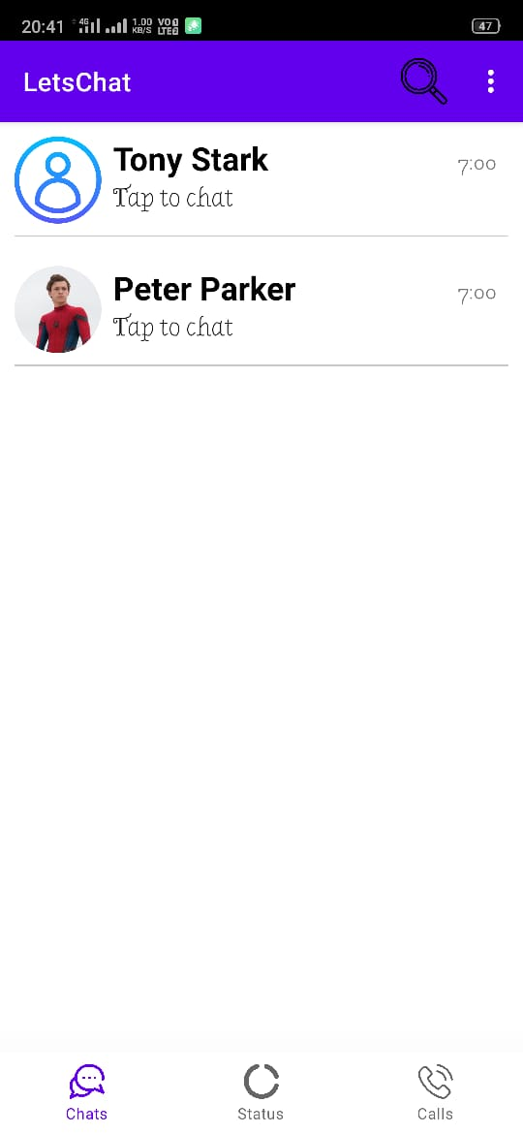
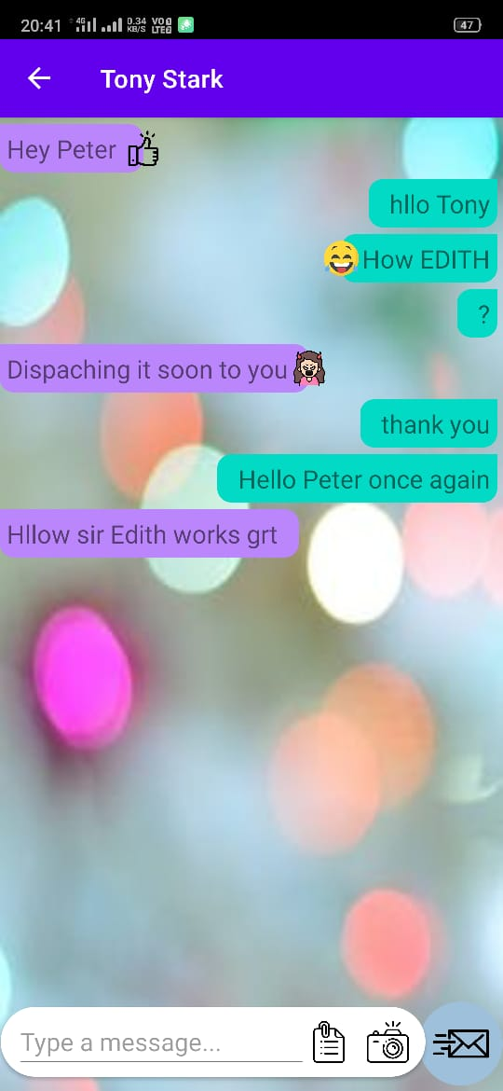
Application Snapshots

Slide 12
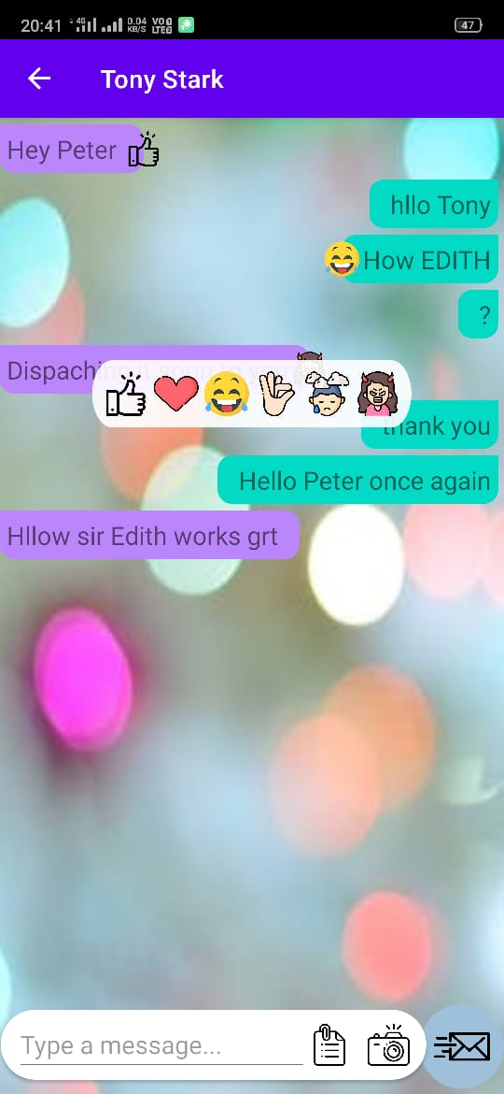
Application Snapshots

Slide 13
Conclusions
The project exposed me to the latest technology in the areas of android development.
Thus, this project successfully demonstrates an online chatting application.
I faced many challenges and problems during the development time.
It was a nice learning curve to work on android applications.

Slide 14


